Slide 1
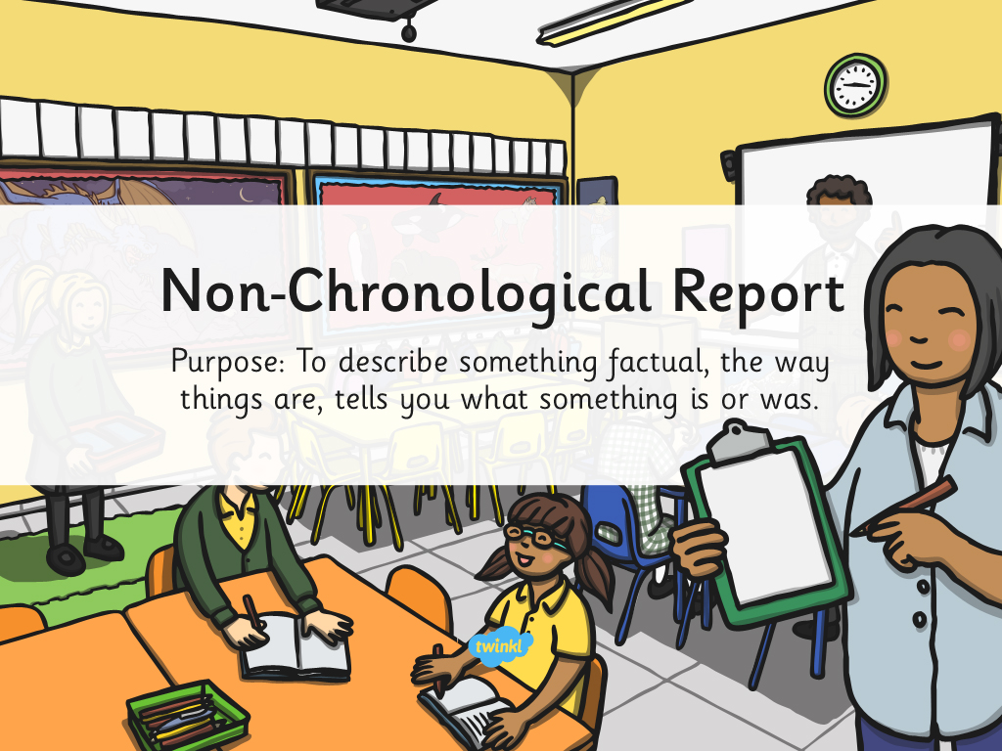

Slide 2
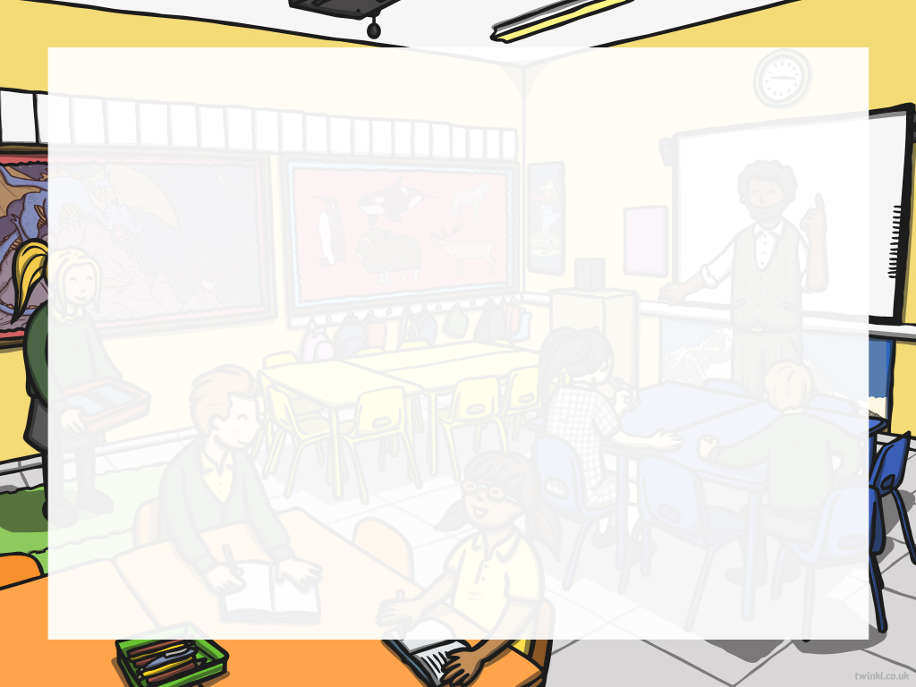
Structure
Opening statement – Introduce the information
Who are you writing about?
What is it or what is it used for?
Where is it found?
When is it found?
Description of topic or situation including some or all of its:
Qualities – Birds have feathers.
Parts and their functions – The beak is…
Habits or behaviours or uses – They build nests out of twigs and sticks.

Slide 3
Planning and research is very important when writing a
non-chronological report.
Plan what paragraphs are needed and what is going under them.
Planning and Research
It is helpful to write in note form while planning.
Use a range of resources to gather information.
Select facts from a range of sources to interest the reader.
Books
Interviews
Films and TV documentaries

Slide 4
Write using short sentences - it makes it clear and gives more emphasis on the point.
Use headings and subheadings.
The Report
Tempt the reader using questions. Make them think.
Use diagrams and captions to help explain leading lines or interesting facts.
Use simple clear titles.

Slide 5
Finally, re-read.
Have you written a clear, factual, well organised report?
If so, well done!

Slide 6


