Slide 2
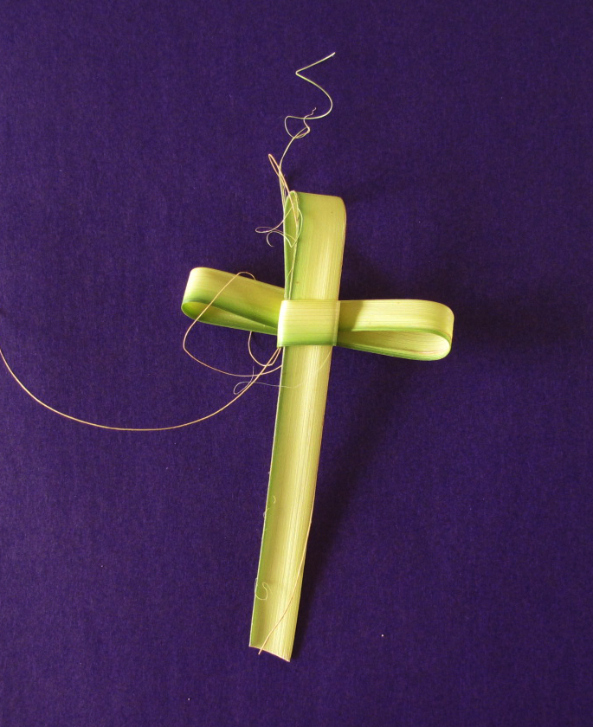
Why Is Palm Sunday Important to People Who Follow the Christian Faith?
Palm Sunday marks the start of holy week for Christians. This is the week leading up to Easter, Jesus' last week on Earth.
Christians feel happy because they are praising Jesus but also sad because they know it was only one week later that Jesus died.
Traditionally, in churches on Palm Sunday, people are given a cross made from a single palm leaf.
Photo courtesy of latrenza (@flickr.com) - granted under creative commons licence – attribution

Slide 3
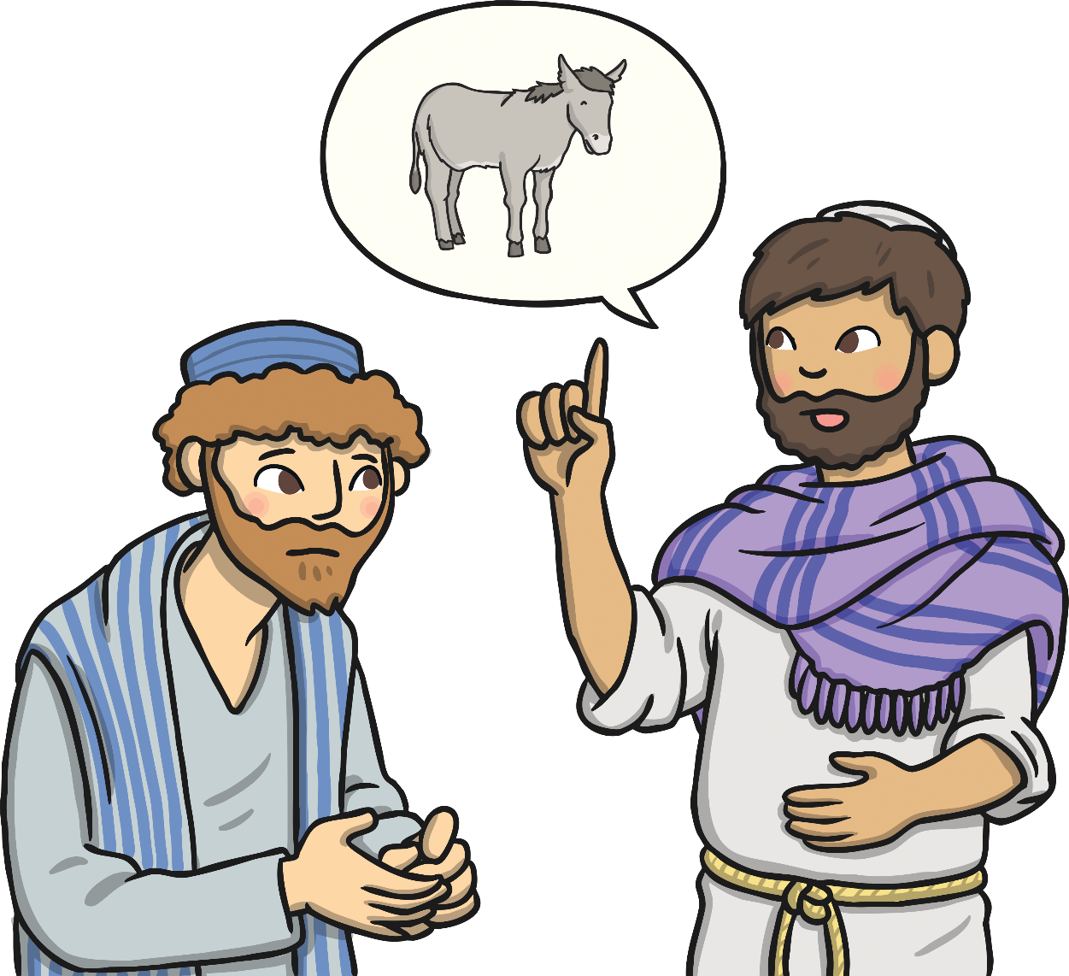
The True King
Jesus and his followers went to Jerusalem for the Passover Feast. Jesus told two of his followers to bring him a donkey and told them where to find it.
He also said, “Tell the people of Jerusalem your King is coming, he is gentle and riding on a donkey.”
The followers did as Jesus asked, they found and bought the animal to Jesus. They lay their cloaks on its back and Jesus sat on them and rode on the donkey.

Slide 4
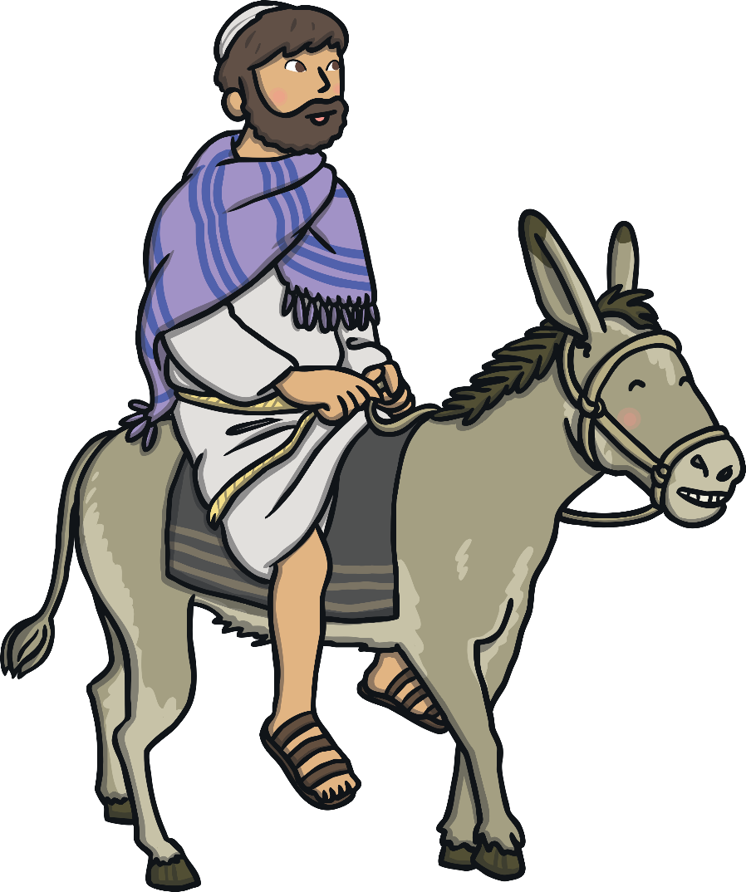
The True King
As Jesus rode the donkey towards Jerusalem, people cut branches from the palm trees and placed them and their cloaks on the ground in front of him.
They shouted, “Hosanna! Hosanna! Blessed is the King of Israel!”

Slide 5
The True King
When Jesus entered Jerusalem a large and excited crowd welcomed him and waved palm leaves. They shouted “Hosanna!” because they were so pleased to see him and believed his message.
Jesus went to the Temple where he healed the blind and lame people.

Slide 6
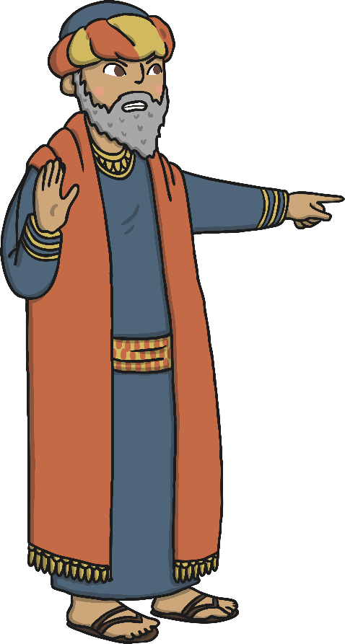
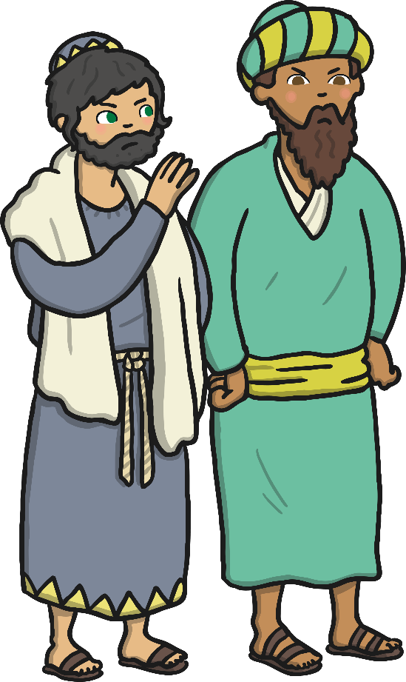
The True King
The leaders in Jerusalem did not like Jesus. They saw how many people were following him and they were angry and jealous.

Slide 7
The True King
Jesus understood that this was part of God’s plan and it would be his last trip into Jerusalem.
People laid down palms in front of him as a sign that they believed his message and that he was King.

