Slide 2
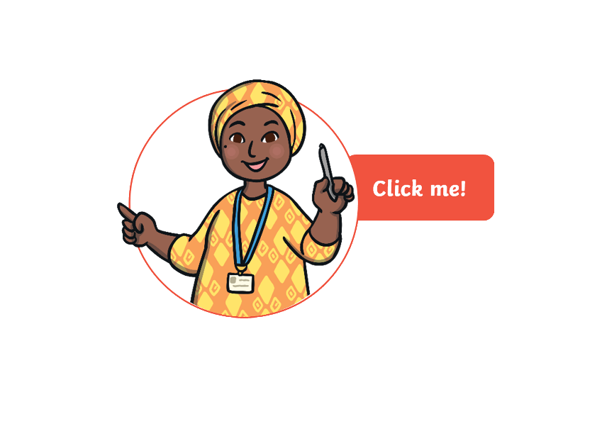
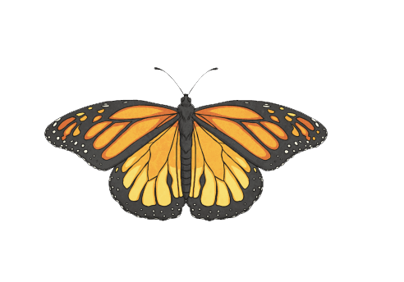
What is symmetry?
Symmetry is where one half of the image is the exact same as the other half.
You could fold the image and both halves would be the exact same.

Slide 3
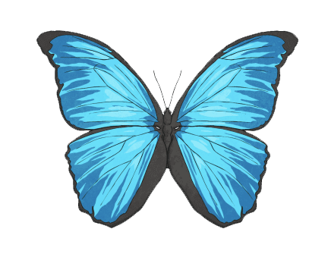
Symmetry in the Environment
We see symmetry all around us.
We can see symmetry in nature, architecture, shapes, letters and lots more.
A butterfly has symmetry. If you draw a line down the middle of the butterfly, both sides would be the same.

Slide 4
Lines of symmetry
Symmetry is where one half of the image is the exact same as the other half.
You could fold the image and both halves would be the exact same.

Slide 5
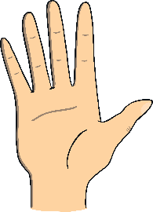
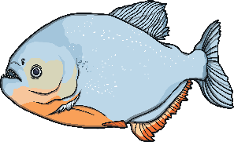
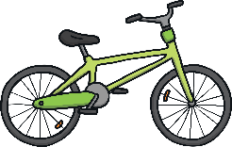
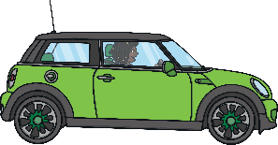
Symmetry sort
Click on the objects to reveal which box they fit into.
With Symmetry:
Without Symmetry:

Slide 6
What is a line of symmetry?
A: A line that divides a shape into quarters
B: A line drawn through a shape so that both sides look the same
C: A line that outlines the edges of a shape

Slide 7
Try again!
Back

Slide 8
Correct!

Slide 9
Which shape has just 4 lines of symmetry?
A: A square
B: A rectangle
C: A parallelogram

Slide 10
Try again!
Back

Slide 11
Correct!

Slide 12
Which shape has just 2 lines of symmetry?
A: A rectangle
B: A circle
C: An equilateral triangle

Slide 13
Try again!
Back

Slide 14
Correct!

Slide 15
Which of these statements is false?
A: A rectangle has 4 lines of symmetry
B: An isosceles triangle has one line of symmetry
C: A square has 4 lines of symmetry

Slide 16
Try again!
Back

Slide 17
Correct!

Slide 18
Which shape has an infinite amount of lines of symmetry?
A: A circle
B: A rectangle
C: A scalene triangle

Slide 19
Try again!
Back

Slide 20
Correct!

